Slide 1
E BOOK APPLICATION
V Bharath(192111247)

Slide 2
OUTLINE
ABSTRACT
OBJECTTIVES
INTRODUCTION
ADVANTAGES
EXISTING WORK
PROPOSED WORK
SOFTWARE REQUIREMENTS
SCREENSHOT OF OUTPUTS
CONCLUSION
FUTURE ENHANCEMENTS
REFERENCES

Slide 3
ABSTRACT
The purpose of this project is to develop an e-book application that enables users to read books on their mobile devices.
The app will be available on 8Android platforms and will feature a user-friendly interface, easy payment options, and a large collection of books in various genres.

Slide 4
OBJECTIVE
The objective is to meet the growing demand for e-books and to offer user a better reading experience to users by providing them with personalized recommendations.
The ultimate goal is to provide a seamless and enjoyable reading experience to users, making it the preferred choice for their e-book needs.

Slide 5
INTRODUCTION
In today's world, e-books have become increasingly popular due to their convenience and accessibility. The demand for e-book reading applications has risen dramatically over the past few years, and it is important to offer an app that meets the needs and expectations of users
The E-book reader is a software platform for reading books which can be installed in mobile phones ,laptops ,computers .
This software allows users to read books without internet ,change the view and navigate through the books easily.

Slide 6
ADVANTAGES OF E-BOOK APP
Save a trip to the Library.
No late fees.
No page tearing
Read anytime, anywhere.
One device, many books.
Search in seconds. ...
Customize how you read.
collection is always growing.

Slide 7
EXISTING WORK
The user interface and user experience have been carefully designed to provide a seamless and intuitive experience for users.
The database has been set up to store information about books, users, favorite books , read books.

Slide 8
PROPOSED WORK
Realistic reading experience for a user
Lighting adjustment
Sorting the books
Searching books by author ,book name
Screen paging and drag scroll
Add books from internal storage

Slide 9
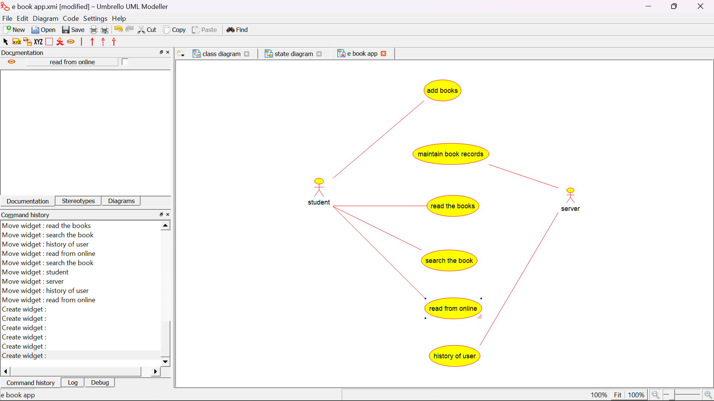
USE CASE DIAGRAM

Slide 10
REQUIREMENTS
Personal computer/Desktop
Android studio application
Sdk tools
Jdk tools
Mobile phone

Slide 11
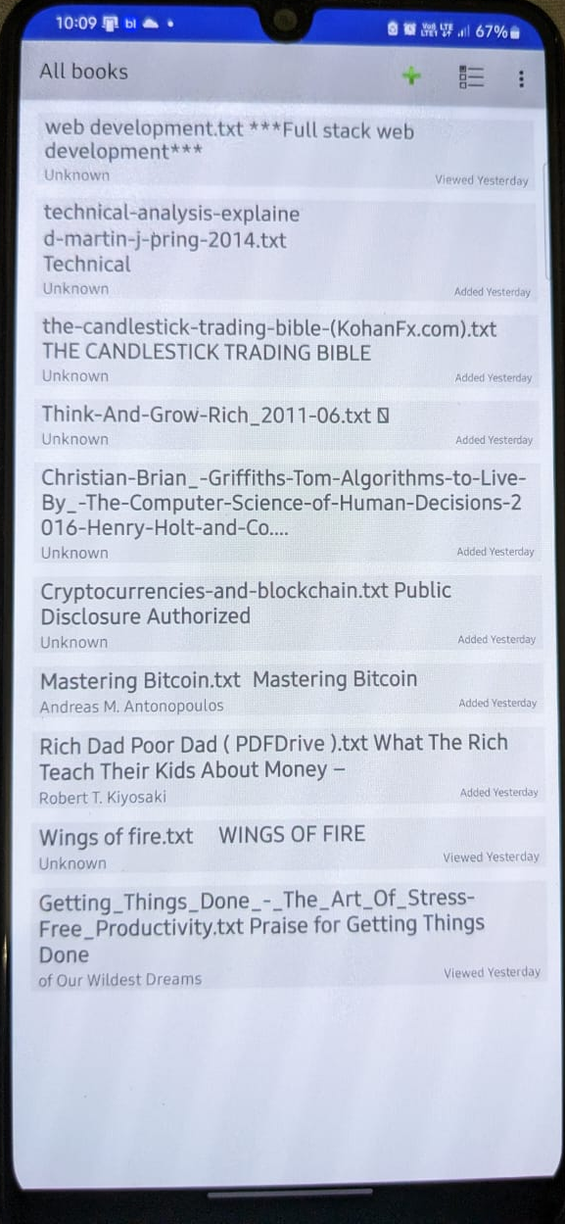
OUTPUTS

Slide 12
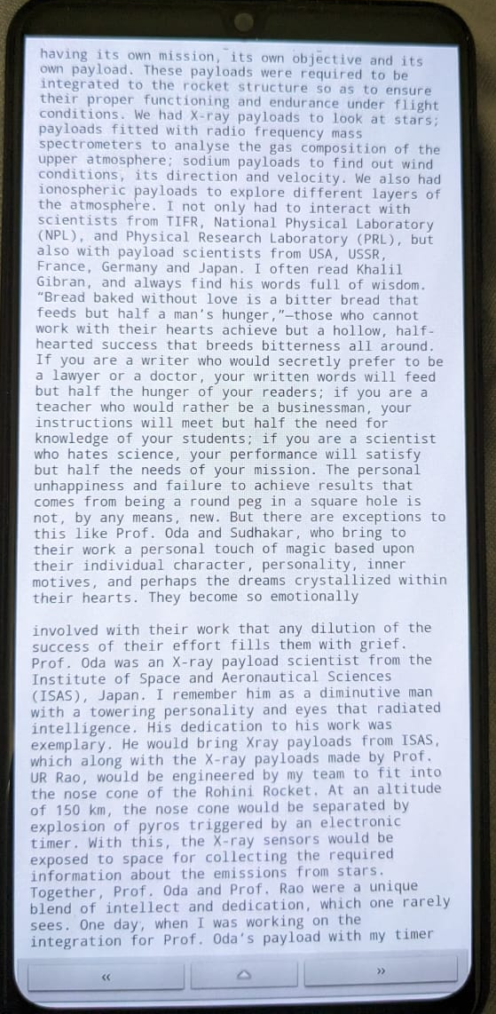
Sample preview of book

Slide 13
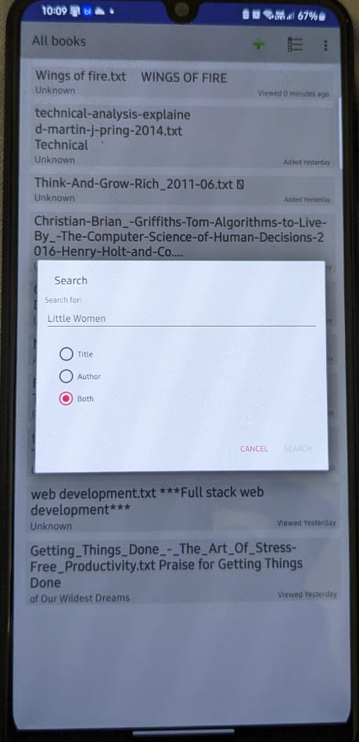
search

Slide 14
CONCLUSION
In conclusion, the development of an e-book application is an important project aimed at meeting the growing demand for convenient and accessible e-books.
The app will offer a user-friendly interface,and a large collection of books in various genres. The existing work in the project includes market research, design, development, testing, and deployment.
With its user-friendly interface and wide selection of books, the e-book app is poised for success and will provide a valuable service to users.

Slide 15
FUTURE ENHANCEMENTS
Marketing and Promotion: To ensure the success of the app, it is important to create awareness and interest among potential users. This includes launching a marketing campaign, utilizing social media, and reaching out to potential partners to promote the app.
User Acquisition and Retention: The focus will be on acquiring and retaining users by providing them with a high-quality reading experience. This includes regularly updating the app with new features and books, providing excellent customer support, and offering promotions and discounts to users.
Content Acquisition and Management: The app will continue to expand its collection of books by partnering with publishers and authors. A system will be put in place to manage the content and ensure that it is up-to-date and accurate
.

Slide 16
Analytics and Optimization: Analytics will be used to track key metrics such as user behavior, usage patterns, and performance. Based on this information, the app will be optimized to provide an even better experience for users.
Technology Integration and Upgrades: The app will be continuously updated with the latest technologies to ensure that it remains competitive and relevant. This may include adding new payment options, integrating with new services, or upgrading existing features.

Slide 17
REFERENCES
Callahan , K., & Sadeghi, L. (2015). Educational leadership in action: A casebook for aspiring educational leaders. Routledge
Lewis, C. S., Walmsley, L., & Cosham, R. (2014). Education and history [Audiobook]. Blackstone Audio. https://www.hoopladigital.com/title/11037643

Slide 18
Thank You

